Slide 1

TEAMUP — ACADEMIC COLLABORATION SYSTEM

Slide 2
Group Members
Adiba Muttaqin 2023-2-60-028
Arafat Mahmud Towhid 2023-2-60-087
Mohammad Tauhid Hossain 2023-2-60-132
Yeamin Rahman Mahid 2023-3-60-375

Slide 3

THE PROBLEM
Teams form ad-hoc — group chats, hallway talk, faculty grouping
Teammates’ real skills are unknown, so teams end up unbalanced
Finding the right supervisor is slow and opaque
Work scatters across chats, drives, and notice boards
Contributions go untracked; good work disappears every semester

Slide 4

WE ASKED STUDENTS
▶ Anonymous online survey — 30 respondents
▶ Goal: validate the problems and measure real demand
▶ Covered five areas:
– Forming teams and finding teammates
– Finding and approaching supervisors
– Collaboration tools and tracking
– Finding learning / project resources – Hearing about academic events

Slide 5
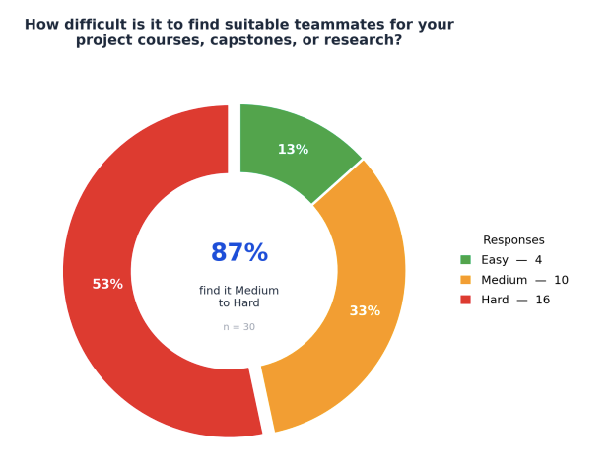
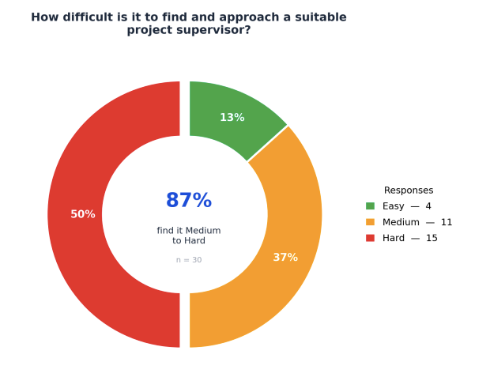
FINDING TEAMMATES & SUPERVISORS IS HARD
87% find forming a team Medium-to-Hard
87% say the same about getting a supervisor

Slide 6
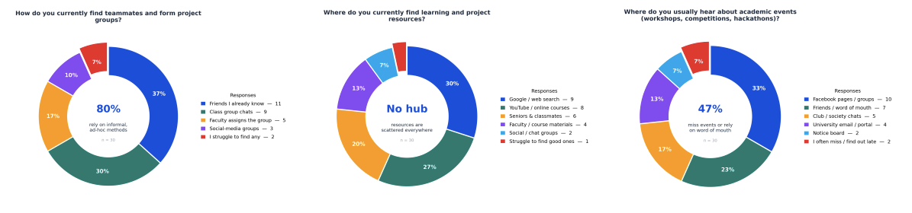
TODAY’S TOOLS & INFORMATION ARE SCATTERED
▶ 80% rely on informal methods to find teammates
▶ Resources spread across Google / YouTube / seniors — no shared hub
▶ 47% miss events or only hear by word of mouth

Slide 7
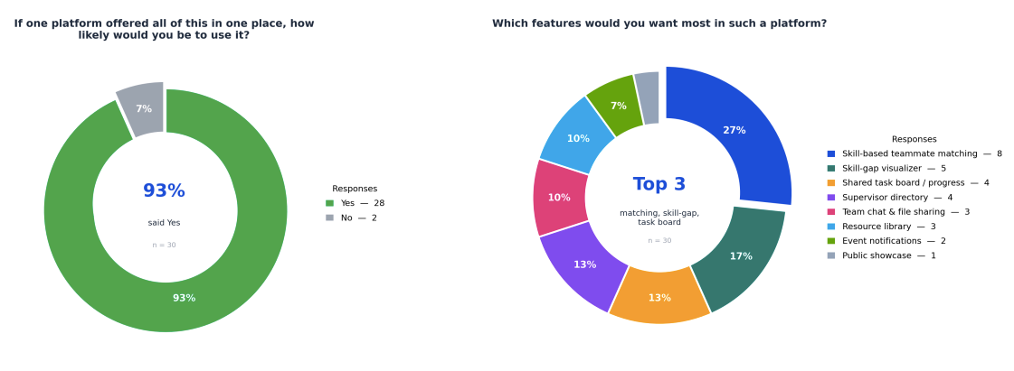
STRONG DEMAND FOR ONE PLATFORM
▶ 93% would use a single platform that does it all

Slide 8

OUR SOLUTION: TEAMUP
▶ One platform for the whole project lifecycle:
– Find skill-matched teammates → secure a supervisor
– Collaborate in a shared workspace → showcase the result
▶ Replaces scattered chats, drives, and notice boards
▶ University-only access with verified accounts
▶ Built around one core loop: post → apply → accept → collaborate

Slide 9

WHO USES IT
▶ Student — builds a profile, discovers and forms teams, collaborates, showcases
▶Supervisor / Faculty — accepts requests, monitors (read-only), reviews proposals, approves milestones
▶ Administrator — verifies accounts, moderates content, manages departments & sessions
▶ Guest — can view the public project showcase only

Slide 10

CORE FEATURES
▶ Discovery board: post, search, filter, apply
▶ Skill-matched team formation
▶ Skill-gap visualizer
▶ Supervisor directory + request workflow
▶ Workspace: task board, files, milestones, progress
▶ Proposal tracker (Draft → Approved)
▶ Resource sharing + event notifications
▶ Public showcase + PDF export

Slide 11

FUNCTIONAL REQUIREMENTS (12)
Accounts & Profiles
- Registration, Login, Profiles
Team Formation
- Discovery, Matching, Invitations
Supervision (FR7–8)
- Requests, Capacity, Proposals
Collaboration
- Tasks, Milestones, File Sharing
Completion & Admin (FR11–12)
- Showcase, PDF Export, Administration

Slide 12

NON-FUNCTIONAL REQUIREMENTS
• Security – RBAC, hashed passwords, HTTPS, JWT authentication
• Performance – Page load time < 3 seconds, real-time updates
• Usability – Responsive design, easy to use without training
• Scalability – Supports 500+ concurrent users
• Availability – 99%+ system uptime
• Data Integrity – Permanent records and daily backups

Slide 13
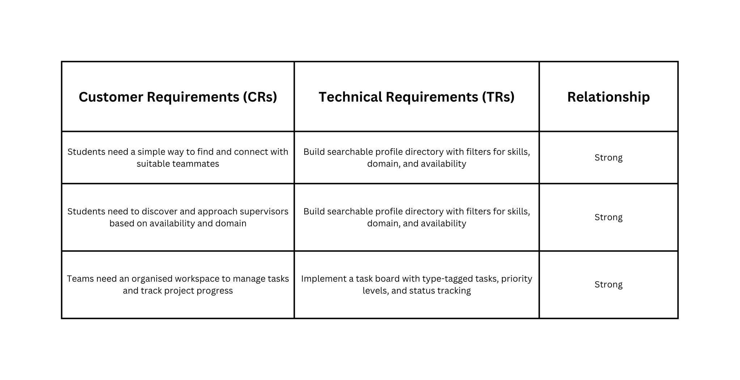
HOUSE OF QUALITY (QFD)

Slide 14

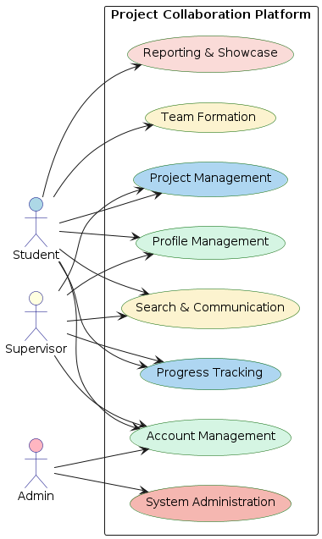
USER INTERACTION
Students create profiles and form teams
Supervisors review requests and approve proposals
Administrators manage users and platform data
System supports end-to-end project lifecycle management

Slide 15

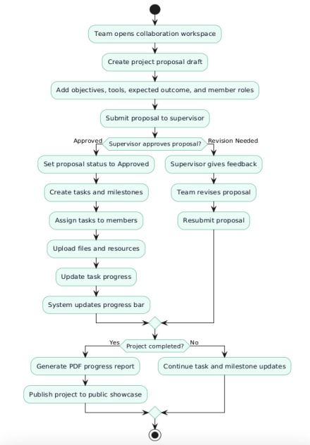
ACTIVITY DIAGRAM
01
Teams draft and submit proposals to supervisors for approval
02
Supervisors provide feedback or request revisions
03
System automatically updates progress bars as tasks are completed
04
Finalized projects trigger PDF exports and public gallery publishing

Slide 16
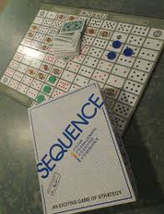
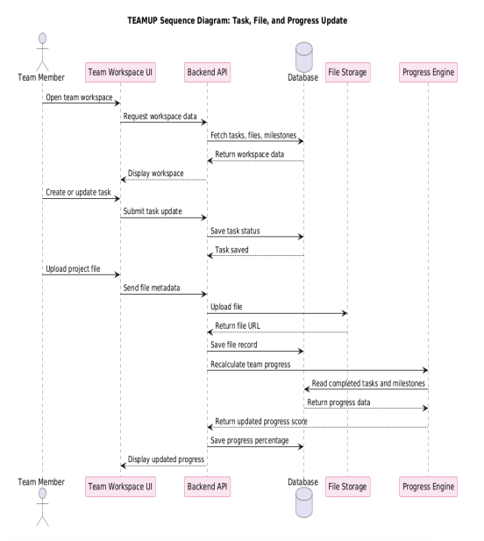
SEQUENCE DIAGRAM
01
Team leaders search for students matching specific skill profiles
02
The system sends real-time notifications for pending invitations
03
Accepting an invitation automatically updates the team database
04
Rejections are recorded and notified back to the team leader

Slide 17
Dedicated Android and iOS mobile applications
FUTURE ENHANCEMENTS EXPAND PLATFORM VALUE
GitHub integration for technical repository managemen
AI-based teammate and supervisor recommendations
Analytics, peer evaluation, and video meeting support

Slide 18

CONCLUSION
TEAMUP — web platform for project team formation, supervision & collaboration
Skill-based teammate matching, skill-gap analysis, task boards, proposal tracking, showcases
Centralized workspace replacing scattered tools
Improves transparency, workflow & coordination
Builds permanent student portfolios

Slide 19
THANK YOU

